Slide 1
SwiftUI in Production: Von Architektur bis ZStack
Daniel Peter, Senior Mobile Engineer @ Deutsche Bahn

Slide 2

Retrospektive
MVVM, MVI, RFP und Bindings
Eine kurze Reise durch den UIKit Dataflow
Agenda
SwiftUI Dataflow
Unidirectional dataflow
Reactive architecture und ihre Prinzipien
Learnings
7 Monate SwiftUI in Production
Ein Lied über Freudetränen und Bauchschmerzen

Slide 3
Retrospektive - MVVC
View Controller
Model
mutates
updates
View
Notes:
Imperative, no observation, MVVC (often MASSIVE view controllers)

Slide 4
Retrospektive - MVVM
ViewModel
sends intents
Model
mutates
View
(Controller)
updates
Notes:
Counter measure gegen große VCs, Auslagerung von Business Logic, VM als Mapping von Model Data zu View Data, VC in allen folgenden Slides View

Slide 5
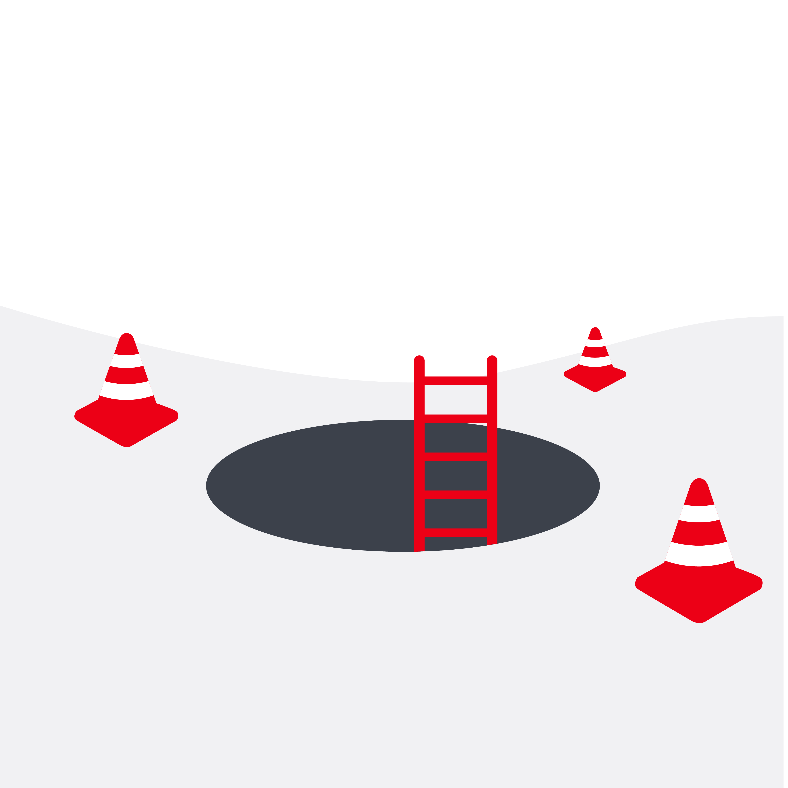
Retrospektive – Imperative Architekturen
State Management
Dependency Injection
Composability
Reusability

Slide 6
Retrospektive - Modern MVVM + RFP
ViewModel
Model
observes
bound to
View
notifies
Notes:
State management, State always in sync (hehe, Sink) as ViewModel reacts to model changes, maps to View Data and view binds the values.

Slide 7
Retrospektive - Layered Architecture
View Layer
View
ViewController
Intents
Mapped Model
Interactor
Intent Layer
Coordinator
Repository
Presenter
ViewModel
Service
Mutations
Updates
Model Layer
Entity
Model
State
Notes:
Egal ob MVVM, VIPER, VIP, MVI, …,

Slide 8
Retrospektive
MVC, MVVM, RFP und Bindings
Eine kurze Reise durch den UIKit Dataflow
Agenda
SwiftUI Dataflow
Unidirectional dataflow
Reactive architecture und ihre Prinzipien
Learnings
7 Monate SwiftUI in Production
Ein Lied über Freudetränen und Bauchschmerzen

Slide 9
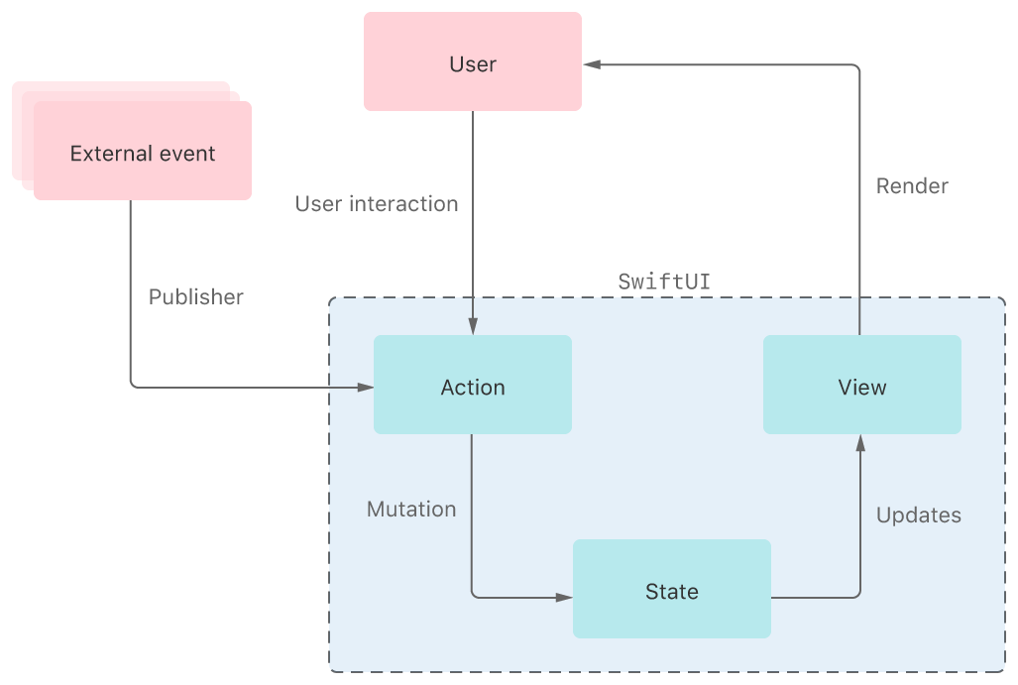
SwiftUI Dataflow – Unidirectional Dataflow
Intent
Model
https://developer.apple.com/documentation/swiftui/state-and-data-flow
Notes:
Egal ob MVVM,

Slide 10
SwiftUI Dataflow – Simplified Unidirectional Dataflow
State
on Change:
update
Action
View
Notes:
Layered Architecture: Wo ist das Interaction Layer? Apple

Slide 11
SwiftUI Dataflow – State Management in SwiftUI
 | Owned by view | Owned somewhere else
Basic | @State | @Binding
Complex | @StateObject | @ObservedObject @EnvironmentObject
Notes:
Layered Architecture: Wo ist das Interaction Layer? Apple

Slide 12
SwiftUI Dataflow – Observable Objects
Observable Object Protokoll
Kann in Views observed werden (als @ObservedObject, @StateObject, @EnvironmentObject)
Published events, wenn @Published properties sich ändern
Class-bound
@Published
Property wrapped
Changes werden in Observable Objects automatisch gepublished und führen zu View Updates
Class-bound

Slide 13
SwiftUI Dataflow – Apple’s MVVM-like approach
Observable Objects
State
mutates
Store
on Change:
update
Action
View
Notes:
The return of the interaction layer (kind of)

Slide 14
SwiftUI Dataflow – Structs vs Classes
UIKit
Views / ViewController sind Classes
Interaction Layer sind Classes/Structs
Model sind Structs
SwiftUI (Apple’s approach)
Views sind Structs
Interaction Layer sind Classes
Model sind Classes / basic data types

Slide 15
Demo time
Apples Store approach

Slide 16
Probleme – Apples Store approach
State Management
✅
Dependency Injection
⚠️
Composability
⚠️
Reusability
⚠️
Notes:
State management – UI is always in sync, state is always on stream
DI – Stores should be injectable into views, needs some protocol magic. Also, stores are treated like singletons, do we need a store for the stores? Injecting mock services etc. could be hard. No single point where all app dependencies are defined (DI Container, etc.)
Composability – What do we do if a view depends data from multiple stores? Mapping from Model -> View Data happens in Views, how do we test that (Snapshots, computed properties)?
Reusability – Views are tailored to a special store, as stores are injected, business logic is replaceable, but stores are not tailored to intent. Would require another abstraction layer.

Slide 17
Probleme – Apples Store approach
State Management
✅
Views reagieren auf Changes im Model Layer
View mapped Model -> View Data
Stores können “geteilt” werden
Notes:
State management – UI is always in sync, state is always on stream
DI – Stores should be injectable into views, needs some protocol magic. Also, stores are treated like singletons, do we need a store for the stores? Injecting mock services etc. could be hard. No single point where all app dependencies are defined (DI Container, etc.)
Composability – What do we do if a view depends data from multiple stores? Mapping from Model -> View Data happens in Views, how do we test that (Snapshots, computed properties)?
Reusability – Views are tailored to a special store, as stores are injected, business logic is replaceable, but stores are not tailored to intent. Would require another abstraction layer.

Slide 18
Probleme – Apples Store approach
State Management
✅
Dependency Injection
⚠️
Composability
⚠️
Reusability
⚠️
Notes:
State management – UI is always in sync, state is always on stream
DI – Stores should be injectable into views, needs some protocol magic. Also, stores are treated like singletons, do we need a store for the stores? Injecting mock services etc. could be hard. No single point where all app dependencies are defined (DI Container, etc.)
Composability – What do we do if a view depends data from multiple stores? Mapping from Model -> View Data happens in Views, how do we test that (Snapshots, computed properties)?
Reusability – Views are tailored to a special store, as stores are injected, business logic is replaceable, but stores are not tailored to intent. Would require another abstraction layer.

Slide 19
Probleme – Apples Store approach
Dependency Injection
⚠️
Stores werden in Views injected
Sind globale Stores singletons? Brauchen wir einen Store Store?
Dependencies nicht an einem zentralen Ort definiert
Notes:
State management – UI is always in sync, state is always on stream
DI – Stores should be injectable into views, needs some protocol magic. Also, stores are treated like singletons, do we need a store for the stores? Injecting mock services etc. could be hard. No single point where all app dependencies are defined (DI Container, etc.)
Composability – What do we do if a view depends data from multiple stores? Mapping from Model -> View Data happens in Views, how do we test that (Snapshots, computed properties)?
Reusability – Views are tailored to a special store, as stores are injected, business logic is replaceable, but stores are not tailored to intent. Would require another abstraction layer.

Slide 20
Probleme – Apples Store approach
State Management
✅
Dependency Injection
⚠️
Composability
⚠️
Reusability
⚠️
Notes:
State management – UI is always in sync, state is always on stream
DI – Stores should be injectable into views, needs some protocol magic. Also, stores are treated like singletons, do we need a store for the stores? Injecting mock services etc. could be hard. No single point where all app dependencies are defined (DI Container, etc.)
Composability – What do we do if a view depends data from multiple stores? Mapping from Model -> View Data happens in Views, how do we test that (Snapshots, computed properties)?
Reusability – Views are tailored to a special store, as stores are injected, business logic is replaceable, but stores are not tailored to intent. Would require another abstraction layer.

Slide 21
Probleme – Apples Store approach
Testability
⚠️
Was tun, wenn mehrere Datenquellen kombiniert werden müssen?
Mapping Model -> View Data in Views
Durch Bindings direkte State Mutationen ohne Action möglich
Notes:
State management – UI is always in sync, state is always on stream
DI – Stores should be injectable into views, needs some protocol magic. Also, stores are treated like singletons, do we need a store for the stores? Injecting mock services etc. could be hard. No single point where all app dependencies are defined (DI Container, etc.)
Composability – What do we do if a view depends data from multiple stores? Mapping from Model -> View Data happens in Views, how do we test that (Snapshots, computed properties)?
Reusability – Views are tailored to a special store, as stores are injected, business logic is replaceable, but stores are not tailored to intent. Would require another abstraction layer.

Slide 22
SwiftUI Dataflow – Binding breaks unidirectional dataflow
Observable Objects
State
binding
mutates
Store
on Change:
update
Action
View
Notes:
Binding setzt auf keine Action, sondern mutiert den State direkt.

Slide 23
Probleme – Apples Store approach
State Management
✅
Dependency Injection
⚠️
Composability
⚠️
Reusability
⚠️
Notes:
State management – UI is always in sync, state is always on stream
DI – Stores should be injectable into views, needs some protocol magic. Also, stores are treated like singletons, do we need a store for the stores? Injecting mock services etc. could be hard. No single point where all app dependencies are defined (DI Container, etc.)
Composability – What do we do if a view depends data from multiple stores? Mapping from Model -> View Data happens in Views, how do we test that (Snapshots, computed properties)?
Reusability – Views are tailored to a special store, as stores are injected, business logic is replaceable, but stores are not tailored to intent. Would require another abstraction layer.

Slide 24
Probleme – Apples Store approach
Reusability
⚠️
View Stores? -> Weiteres Abstraction Layer
Protokolle für Stores nötig
Wo “leben” Dinge wie Tracking?
Notes:
State management – UI is always in sync, state is always on stream
DI – Stores should be injectable into views, needs some protocol magic. Also, stores are treated like singletons, do we need a store for the stores? Injecting mock services etc. could be hard. No single point where all app dependencies are defined (DI Container, etc.)
Composability – What do we do if a view depends data from multiple stores? Mapping from Model -> View Data happens in Views, how do we test that (Snapshots, computed properties)?
Reusability – Views are tailored to a special store, as stores are injected, business logic is replaceable, but stores are not tailored to intent. Would require another abstraction layer.

Slide 25
Gibt es eine Alternative?
Ja.

Slide 26
SwiftUI Dataflow – Venns Rache - State
App
State
Home
State
Detail
State
Book
Detail
State
Book
Detail
State
Book
Notes:
Binding setzt auf keine Action, sondern mutiert den State direkt.

Slide 27
SwiftUI Dataflow – Venns Rache - Business Logic
App
Logic
Home
Logic
Detail
Logic
Detail
Logic
Detail
Logic
Notes:
Binding setzt auf keine Action, sondern mutiert den State direkt.

Slide 28
SwiftUI Dataflow – Venns Rache - Dependencies
App
Environment
Home
Environment
Detail
Environment
Detail
Environment
Detail
Environment
Notes:
Binding setzt auf keine Action, sondern mutiert den State direkt.

Slide 29

Gibt es eine Alternative?
The Composable Architecture
https://github.com/pointfreeco/swift-composable-architecture

Slide 30
SwiftUI Dataflow – The composable architecture
 | Responsibility | Data Type
State | Model / ViewModel | Struct
Reducer | Business logic | (Pure) function
Environment | Dependency container | Struct, enthält Classes / Structs
Store | State management | Class (Observable Object)
Notes:
Layered Architecture: Wo ist das Interaction Layer? Apple

Slide 31
Demo time
TCA approach

Slide 32
Probleme – TCA approach
State Management
✅
Dependency Injection
✅
Composability
✅
Reusability
✅
Notes:
State management – UI is always in sync, state is always on stream
DI – Stores should be injectable into views, needs some protocol magic. Also, stores are treated like singletons, do we need a store for the stores? Injecting mock services etc. could be hard. No single point where all app dependencies are defined (DI Container, etc.)
Composability – What do we do if a view depends data from multiple stores? Mapping from Model -> View Data happens in Views, how do we test that (Snapshots, computed properties)?
Reusability – Views are tailored to a special store, as stores are injected, business logic is replaceable, but stores are not tailored to intent. Would require another abstraction layer.

Slide 33
Retrospektive
MVC, MVVM, RFP und Bindings
Eine kurze Reise durch den UIKit Dataflow
Agenda
SwiftUI Dataflow
Unidirectional dataflow
Reactive architecture und ihre Prinzipien
Learnings
7 Monate SwiftUI in Production
Ein Lied über Freudetränen und Bauchschmerzen

Slide 34

Learnings – SwiftUI in Production
⚠️
‘Cleaner’, testbarer Code ist mit SwiftUI möglich (mit Unterstützung von TCA noch besser)
Relative viele Bugs in SwiftUI selbst
Fehlender Focus support (firstResponder fehlt komplett)
iOS 13+
Kein Navigator / Router / Coordinator built-in
Nicht open source, fixes bleiben iOS14-only
Notes:
State management – UI is always in sync, state is always on stream
DI – Stores should be injectable into views, needs some protocol magic. Also, stores are treated like singletons, do we need a store for the stores? Injecting mock services etc. could be hard. No single point where all app dependencies are defined (DI Container, etc.)
Composability – What do we do if a view depends data from multiple stores? Mapping from Model -> View Data happens in Views, how do we test that (Snapshots, computed properties)?
Reusability – Views are tailored to a special store, as stores are injected, business logic is replaceable, but stores are not tailored to intent. Would require another abstraction layer.

Slide 35



Learnings – SwiftUI in Production
‘Cleaner’, testbarer Code möglich (mit Unterstützung von BLoC noch besser)
Open Source
Wirklich cross-platform (Native, Web, Desktop)
Navigator built-in
Open source
https://flutter.dev/
Notes:
State management – UI is always in sync, state is always on stream
DI – Stores should be injectable into views, needs some protocol magic. Also, stores are treated like singletons, do we need a store for the stores? Injecting mock services etc. could be hard. No single point where all app dependencies are defined (DI Container, etc.)
Composability – What do we do if a view depends data from multiple stores? Mapping from Model -> View Data happens in Views, how do we test that (Snapshots, computed properties)?
Reusability – Views are tailored to a special store, as stores are injected, business logic is replaceable, but stores are not tailored to intent. Would require another abstraction layer.

Slide 36

Weiteres Lesematerial
RIBs (https://github.com/uber/RIBs)
TCA (https://github.com/pointfreeco/swift-composable-architecture)
State and Dataflow in SwiftUI (https://developer.apple.com/documentation/swiftui/state-and-data-flow)
BLoC (https://bloclibrary.dev/#/)

Slide 37
Fragen?

Slide 38

How to use the illustrations
Please don’t:
Use more than 1 illustration on a slide, BUT: feel free to use as many product illustrations as needed in one screen
Size up illustrations above 4320pt

Slide 39


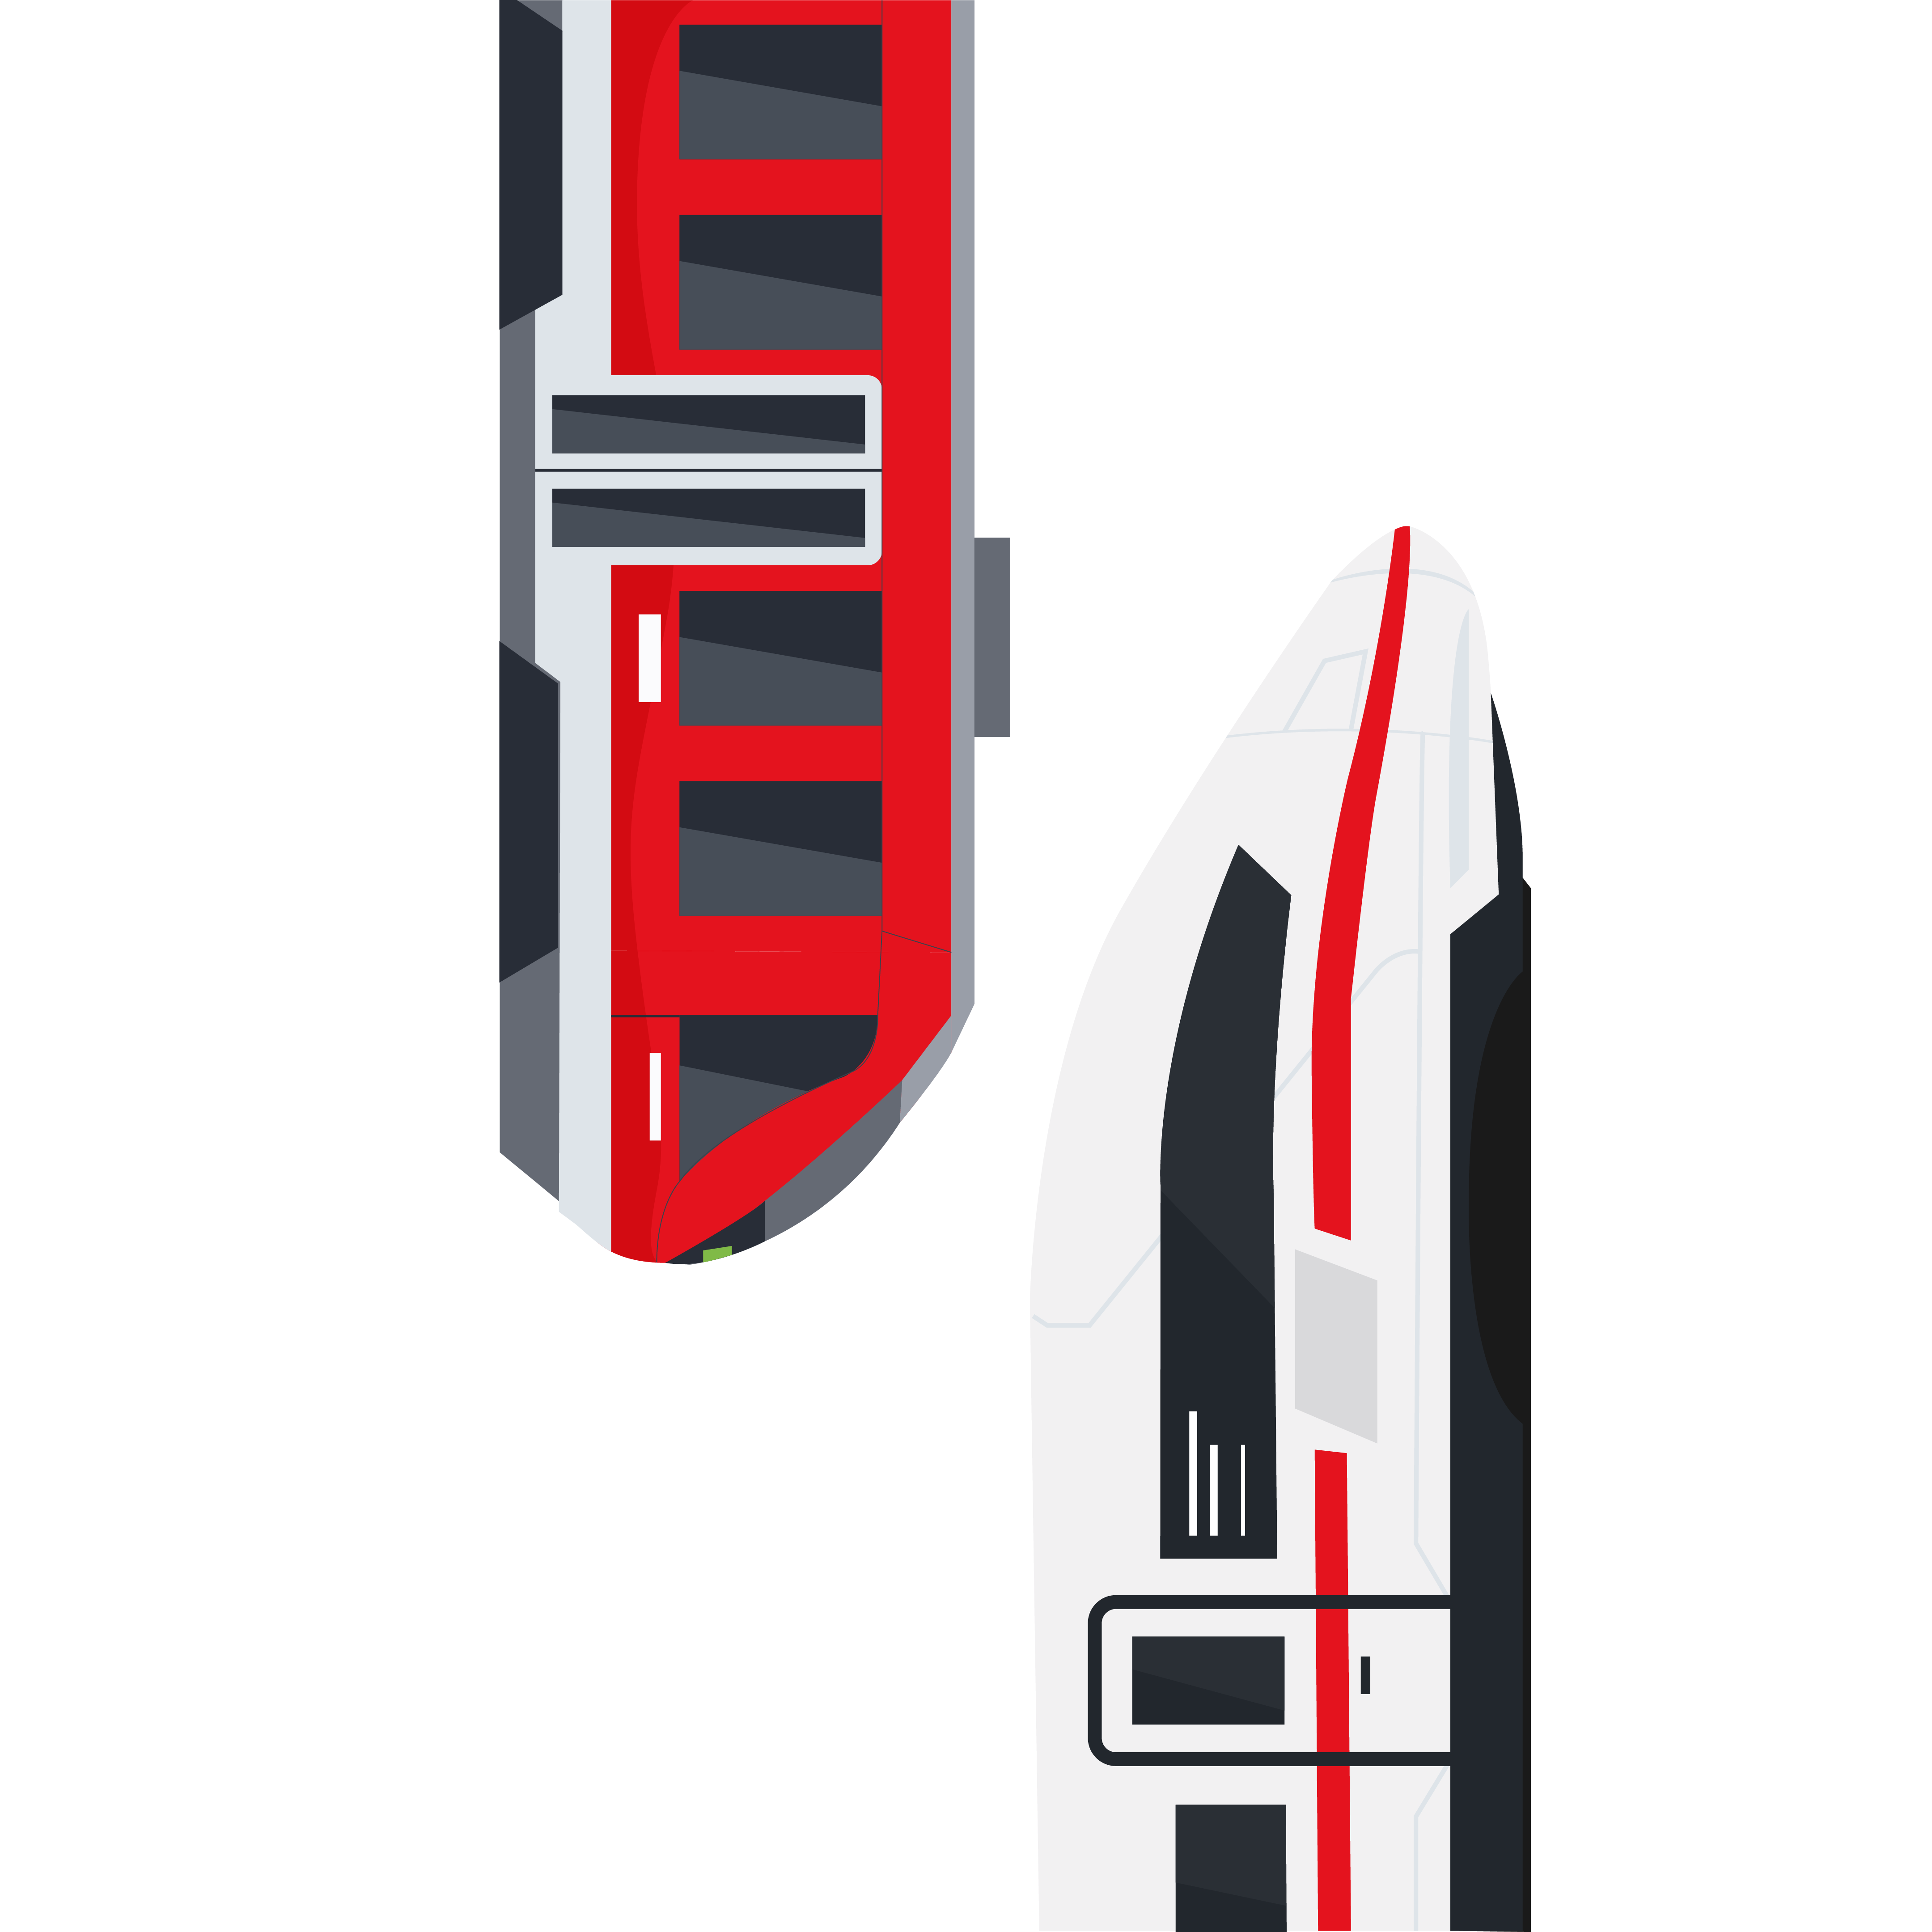

Transportation

Slide 40


Train station

Slide 41




Faces

Slide 42




Families

Slide 43







People

Slide 44








More people

Slide 45




People on the go

Slide 46



Phones

Slide 47




Detailed Illustrations

Slide 48


Detailed Illustrations

Slide 49

Environment

Slide 50










Product Illustrations
Use our product illustrations to illustrate texts on brand.

Slide 51



BahnX

